Slide 1
Discrete Structures
Lecture No.
Spring 2020
Course Instructor : Amna Irum
National University of Computer and Emerging Sciences, Islamabad

Slide 2
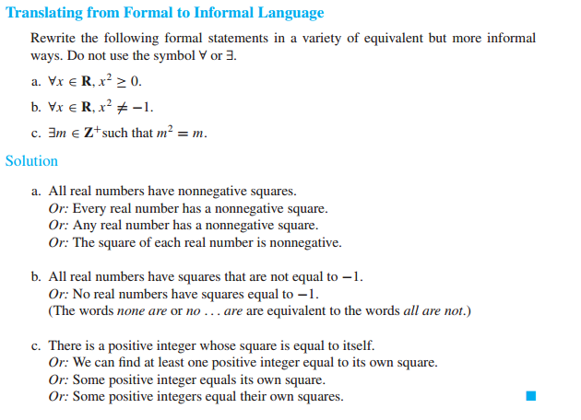
Formal Versus Informal Language

Slide 3
Universal Conditional Statements
∀x, if P(x)then Q(x).

Slide 4
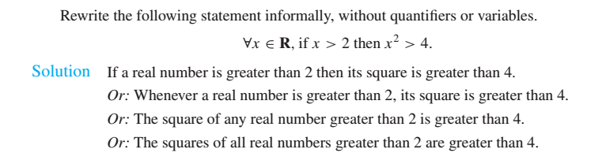

Slide 5
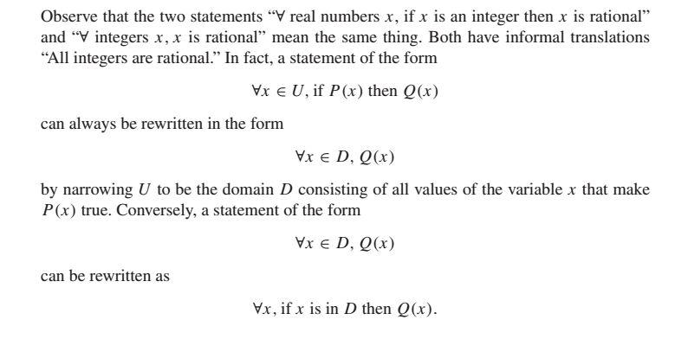
Equivalent Forms of Universal and Existential Statements

Slide 6
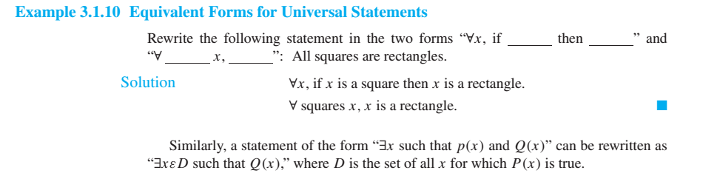

Slide 7
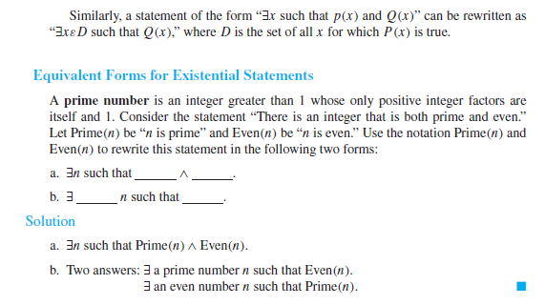


Slide 8


Slide 9
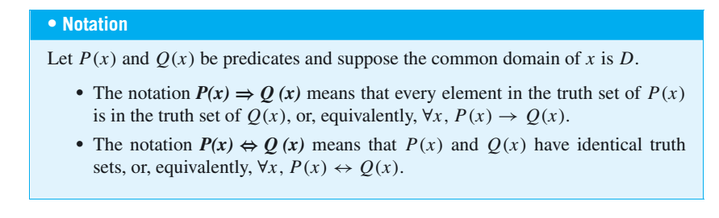

Slide 10
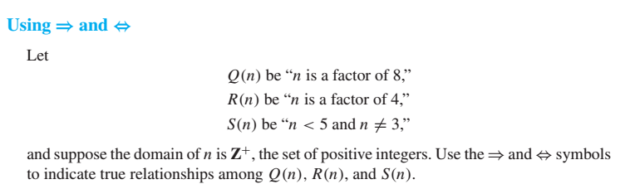
Example

Slide 11
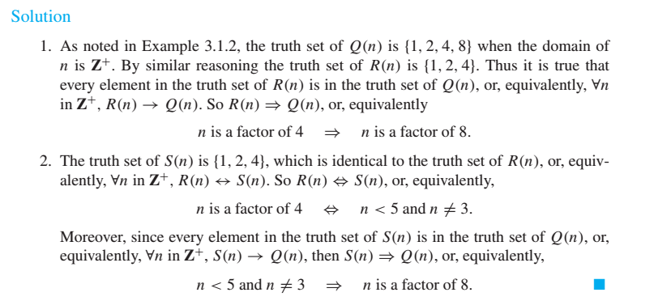

Slide 12
Negations of Quantified Statements
What is the negation of ?
“All Computer Scientists wear glasses.”
“No Computer Scientist wears glasses” (Is it the correct negation???)
But if even one Computer Scientist does not wear glasses, then the sweeping statement that all Computer Scientists wear glasses is false.
So a correct negation is “There is at least one Computer Scientist who does not wear glasses.”

Slide 13
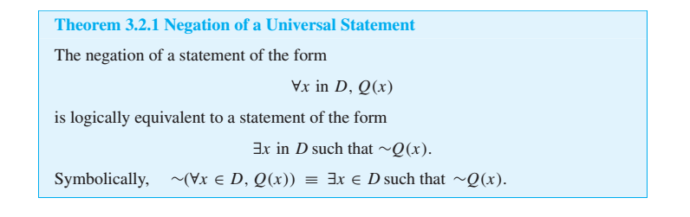
The negation of a universal statement (“all are”) is logically equivalent to an
existential statement (“some are not” or “there is at least one that is not”).

Slide 14
“Some snowflakes are the same.” What is its negation?
For this statement to be false means that not a single snowflake is the same as any other.
In other words, “No snowflakes are the same,” or “All snowflakes are different.”

Slide 15
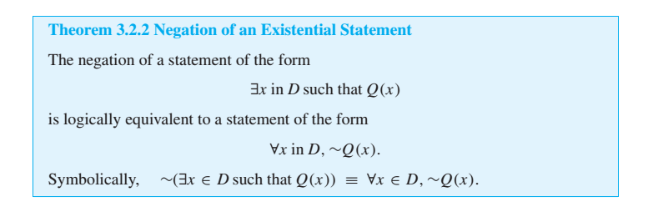
The negation of an existential statement (“some are”) is logically equivalent to a universal statement (“none are” or “all are not”).

Slide 16
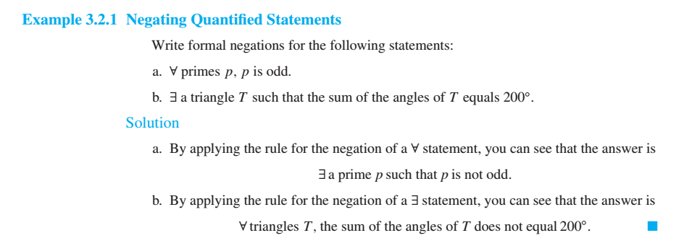

Slide 17
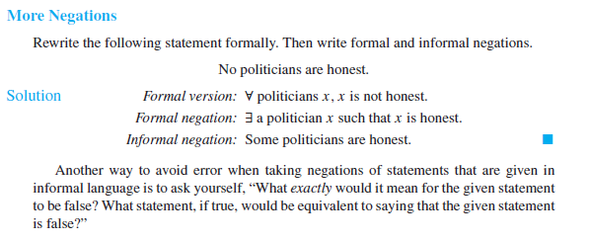
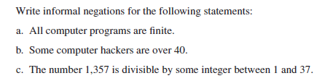

Slide 18
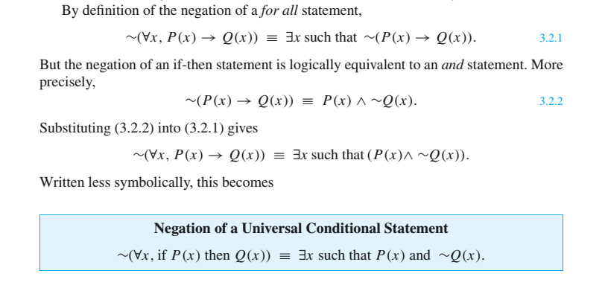
Negations of Universal Conditional Statements

Slide 19
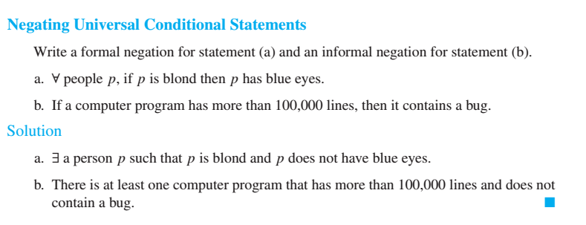
Example

Slide 20
The Relation among ∀,∃,∧,and ∨
The negation of a for all statement is a there exists statement, and the negation of a there exists statement is a for all statement.
These facts are analogous to De Morgan’s
This similarity is not accidental.
In a sense, universal statements are generalizations of and statements, and existential statements are generalizations of or statements.

Slide 21
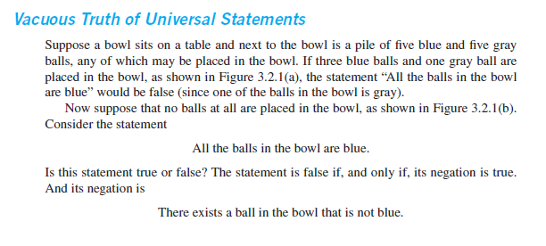

Slide 22
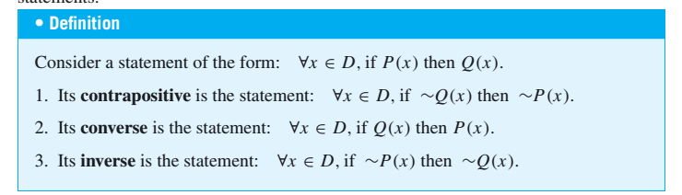
Variants of Universal Conditional Statements

Slide 23
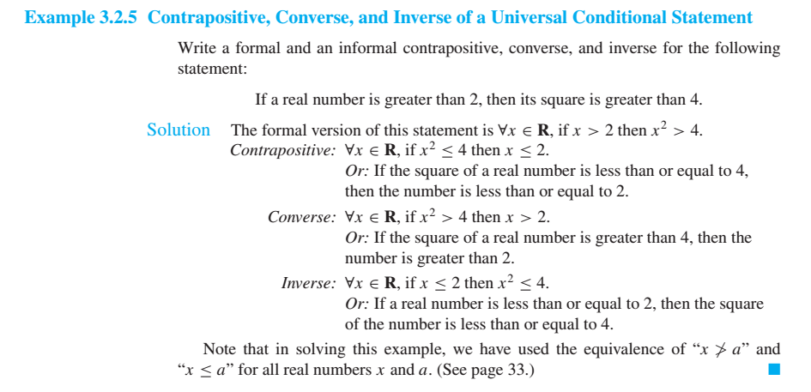

Slide 24
A universal conditional statement is logically equivalent to its contrapositive
A universal conditional statement is not logically equivalent to its converse.
A universal conditional statement is not logically equivalent to its inverse.

Slide 25
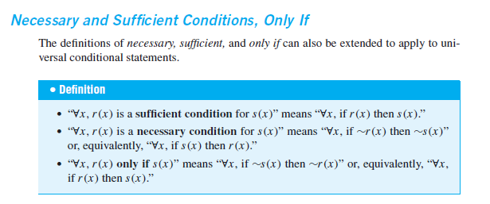

Slide 26
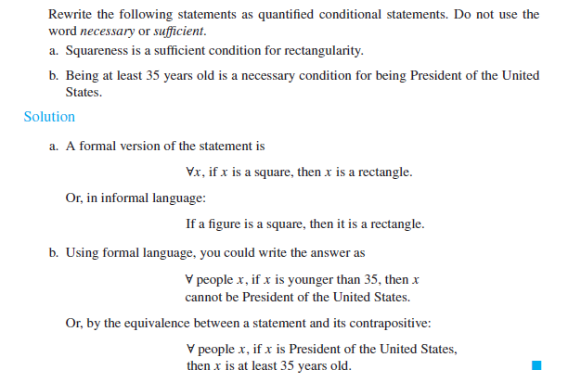

Slide 27
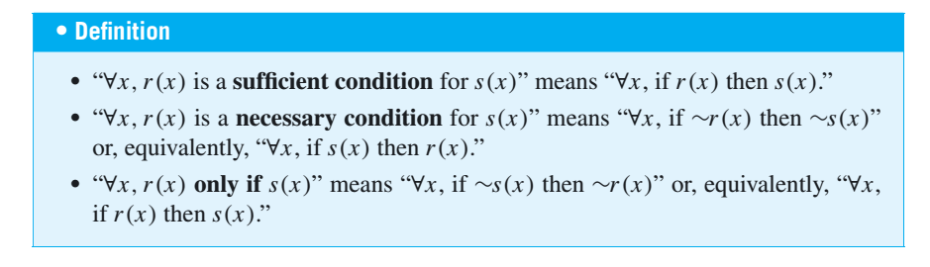
Necessary and Sufficient Conditions, Only If

Slide 28
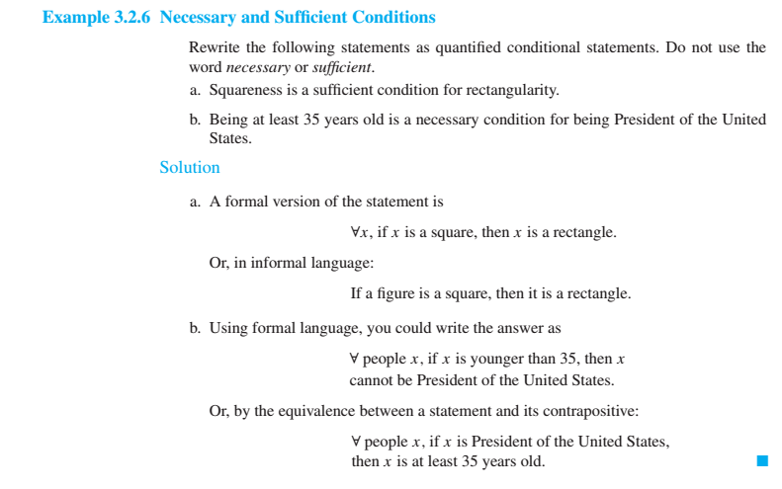

Slide 29
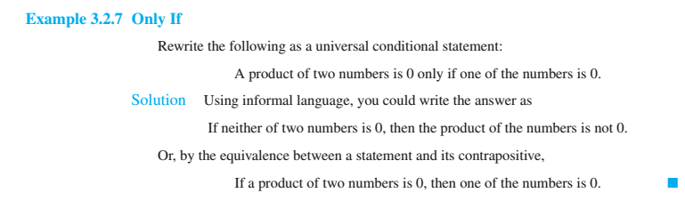

Slide 30
Statements with Multiple Quantifiers
Example: There is a person supervising every detail of the production process
Note that this statement contains informal versions of both the existential quantifier there is and the universal quantifier every.
Which of the following best describes its meaning?
  There is one single person who supervises all the details of the production process.
  For any particular production detail, there is a person who supervises that detail, but there might be different supervisors for different details.

Slide 31
Removing Ambiguity
When a statement contains more than one quantifier, we imagine the actions suggested by the quantifiers as being performed in the order in which the quantifiers occur.

Slide 32
For instance, consider a statement of the form
∀x in set D,∃y in set Esuch that x and y satisfy property P(x,y).
Two challenges:
Imagine that someone is allowed to choose any element whatsoever from the set D, and imagine that the person gives you that element. Call it x.
The challenge for you is to find an element y in E so that the person’s x and your y, taken together, satisfy property P(x,y).

Slide 33
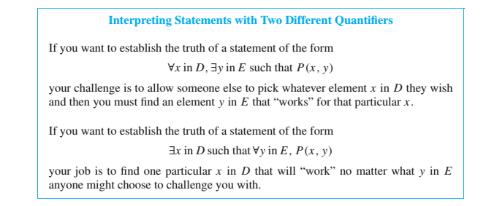

Slide 34
Home Exercise
Example 3.3.3

Slide 35
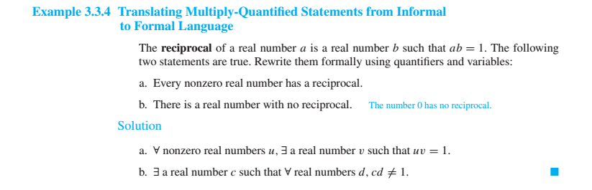

Slide 36
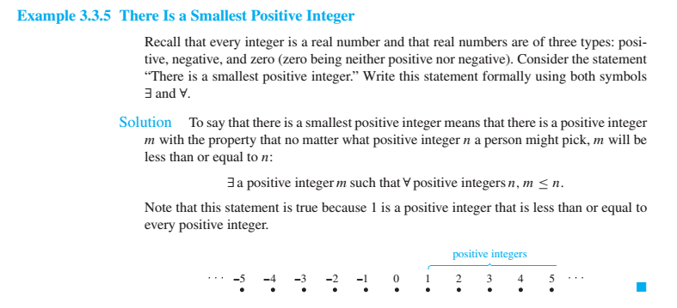

Slide 37
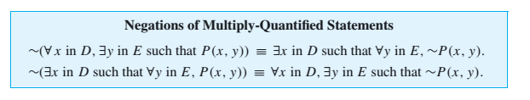

Slide 38



Slide 39
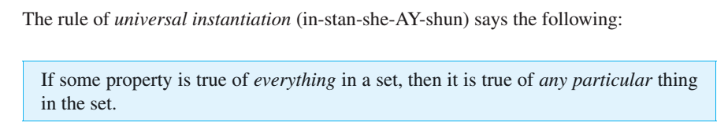
Arguments with Quantified Statements
Use of the words universal instantiation indicates that the truth of a property in a particular case follows as a special instance of its more general or universal truth.
The validity of this argument form follows immediately from the definition of truth values for a universal statement.

Slide 40
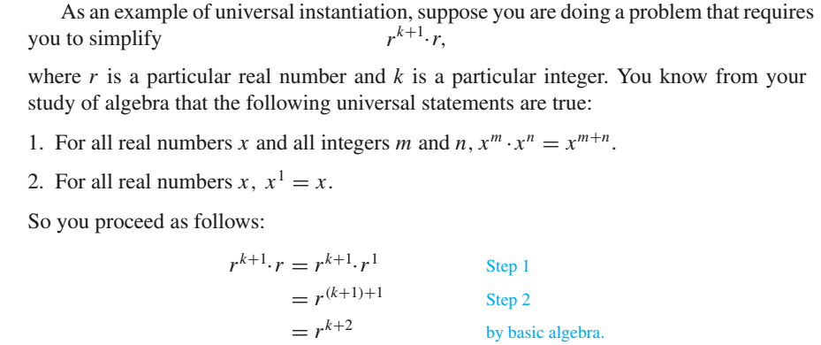
Universal instantiation is the fundamental tool of deductive reasoning.

Slide 41
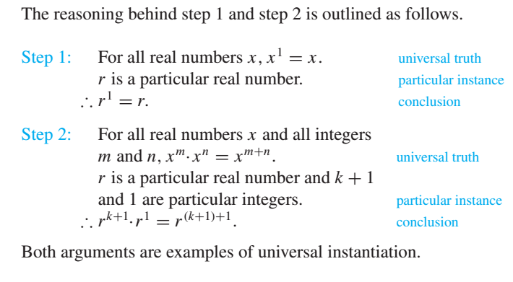

Slide 42
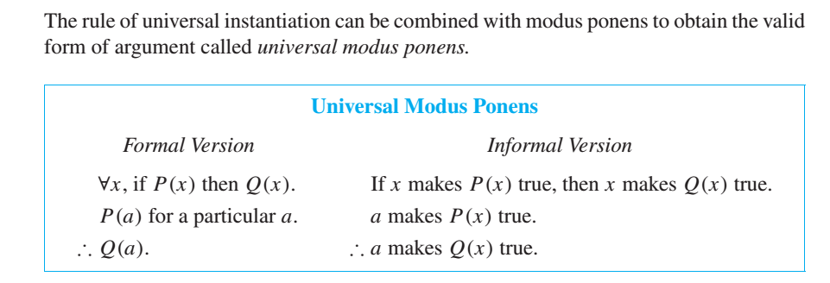
Universal Modus Ponens

Slide 43
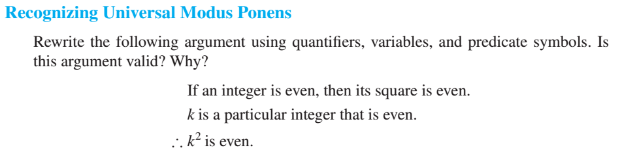

Slide 44
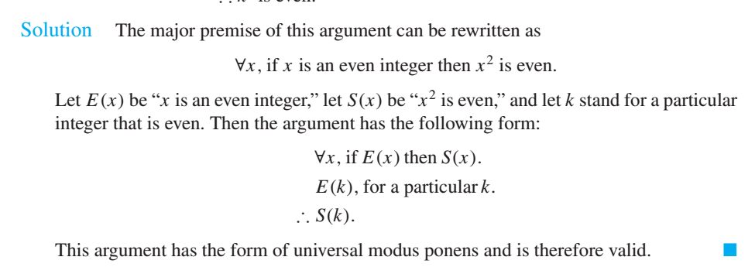

Slide 45
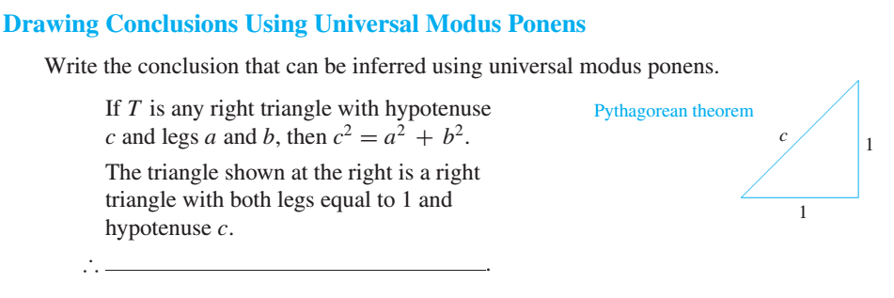

Slide 46


Slide 47
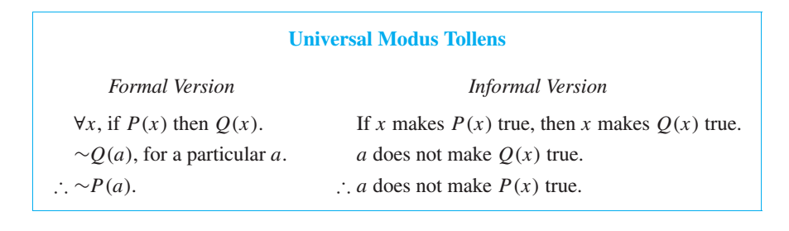
Universal Modus Tollens

Slide 48
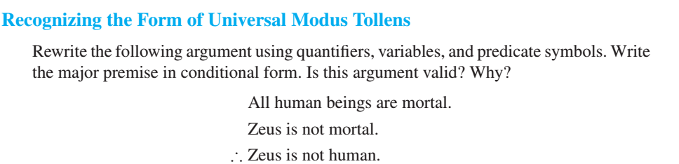

Slide 49
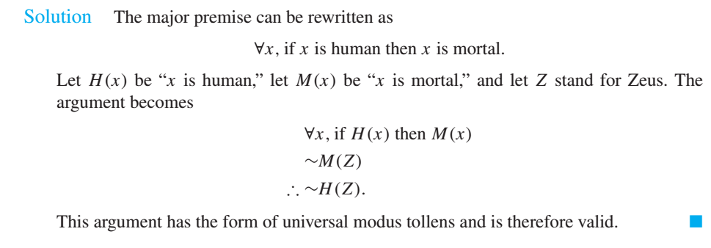

Slide 50
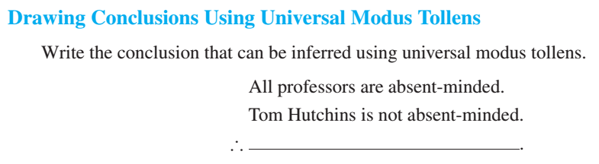

Slide 51


